Slide 1
L’euro
Avviso AOODGEFID\003504 del 31/03/2017. Avviso pubblico per il potenziamento della Cittadinanza europea
Codice progetto PON 10.2.2A-FSEPON-SI-2018-106
CUP D74F18000270006

Slide 2
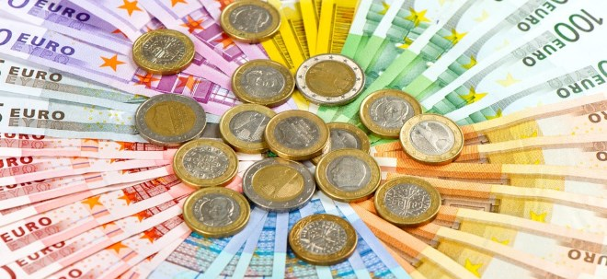
EURO

Slide 3
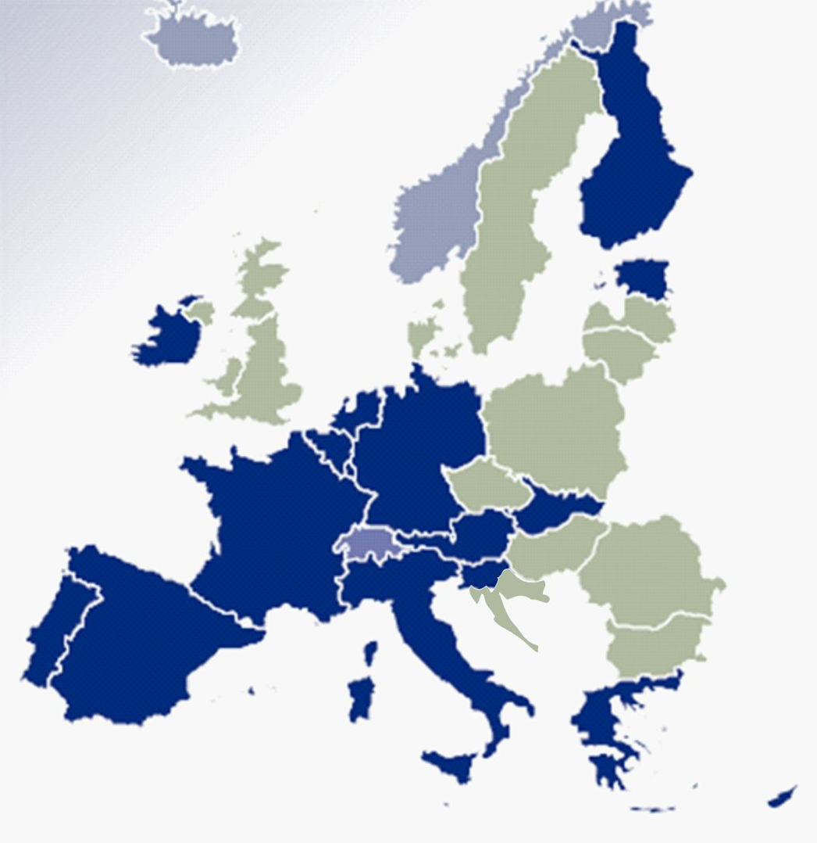
The EURO is the official currency of 19 of 28 member States of the European Union. This group of States is known as the EUROzone. The EURO is the second largest and second most traded currency in the foreign exchange market after the United States dollar.
Countries in the EURO-zone
Countries not in the EU
Countries not in the EURO-ZONE

Slide 4
How much is the Euro?
It is a fact that the euro has become a strong currency over time. In the technical field it can be defined as a strong currency, not a currency that has a strong purchasing power, but one that manages to guarantee stability. compared to the dollar, our currency has become stronger and stronger so as to be a good candidate as a reserve currency. It has even set itself on a path of ascent over the exchange rate with the pound

Slide 5
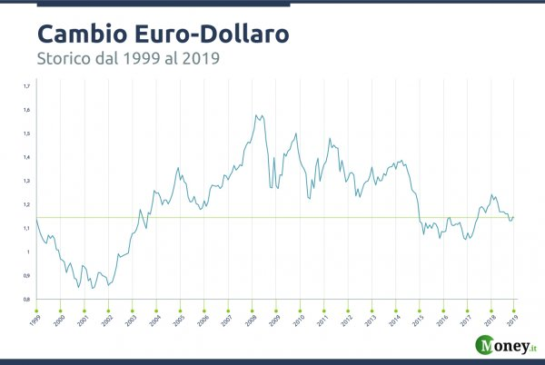

Slide 6
ADVANTAGES
MORE POSSIBILITY OF CHOICE AND PRICE STABILITY FOR CONSUMERS AND CITIZENS;
GREATER SECURITY AND GREATER OPPORTUNITIES FOR COMPANIES AND MARKETS;
GREATER ECONOMIC STABILITY AND GROWTH;
MORE INTEGRATED FINANCIAL MARKETS;
GREATER EU PRESENCE IN THE ECONOMY

Slide 7
DISADVANTAGES
PENALTY EXPORT: goods priced in euros will have a higher value than the dollar, thus losing competitiveness and thus penalizing export companies .

